Slide 1
CS162 Operating Systems and Systems Programming Lecture 15 Demand Paging
March 17th, 2020
Prof. John Kubiatowicz
http://cs162.eecs.Berkeley.edu

Slide 2
Recall: Caching Applied to Address Translation
Virtual
Address
TLB
Physical
Memory
CPU
Physical
Address
Cached?
Yes
No
Save
Result
Translate
(MMU)
Data Read or Write
(untranslated)
Question is one of page locality: does it exist?
Instruction accesses spend a lot of time on the same page (since accesses sequential)
Stack accesses have definite locality of reference
Data accesses have less page locality, but still some…
Can we have a TLB hierarchy?
Sure: multiple levels at different sizes/speeds

Slide 3
Recall: Current x86 (Skylake, Cascade Lake)

Slide 4
Recall: Putting Everything Together: Address Translation
Physical
Memory:
Virtual Address:
Virtual
P1 index
Virtual
P2 index
Offset
PageTablePtr
Physical Address:
Physical
Page #
Offset
Page Table
(1st level)
Page Table
(2nd level)

Slide 5
Recall: Putting Everything Together: TLB
Physical
Memory:
Virtual Address:
Virtual
P1 index
Virtual
P2 index
Offset
PageTablePtr
Physical Address:
Physical
Page #
Offset
Page Table
(1st level)
Page Table
(2nd level)
TLB:
…

Slide 6
Recall: Putting Everything Together: Cache
Physical
Memory:
Virtual Address:
Virtual
P1 index
Virtual
P2 index
Offset
PageTablePtr
Physical Address:
Physical
Page #
Offset
Page Table
(1st level)
tag
index
byte
cache:
Page Table
(2nd level)
tag:
block:
TLB:
…
…

Slide 7
Recall: Page Fault ⇒ Demand Paging
Process
virtual address
physical address
MMU
page#
PT
instruction
frame#
retry
page fault
offset
exception
frame#
Operating System
offset
update PT entry
Page Fault Handler
load page from disk
scheduler

Slide 8
Demand Paging
Modern programs require a lot of physical memory
Memory per system growing faster than 25%-30%/year
But they don’t use all their memory all of the time
90-10 rule: programs spend 90% of their time in 10% of their code
Wasteful to require all of user’s code to be in memory
Solution: use main memory as “cache” for disk
Processor
caching
paging
Control
Tertiary
Storage
(Tape)
Second
Level
Cache
(SRAM)
Main
Memory
(DRAM)
Secondary
Storage
(Disk)
Datapath
On-Chip
Cache

Slide 9
Demand Paging as Caching, …
What “block size”? - 1 page (e.g, 4 KB)
What “organization” ie. direct-mapped, set-assoc., fully-associative?
Any page in any frame of memory, i.e., fully associative: arbitrary virtual → physical mapping
How do we locate a page?
First check TLB, then page-table traversal
What is page replacement policy? (i.e. LRU, Random…)
This requires more explanation… (kinda LRU)
What happens on a miss?
Go to lower level to fill miss (i.e. disk)
What happens on a write? (write-through, write back)
Definitely write-back – need dirty bit!

Slide 10
Illusion of Infinite Memory
∞
TLB
Page
Table
Physical
Memory
512 MB
Disk
500GB
Virtual
Memory
4 GB
Disk is larger than physical memory ⇒
In-use virtual memory can be bigger than physical memory
Combined memory of running processes much larger than physical memory
More programs fit into memory, allowing more concurrency
Principle: Transparent Level of Indirection (page table)
Supports flexible placement of physical data
Data could be on disk or somewhere across network
Variable location of data transparent to user program
Performance issue, not correctness issue

Slide 11
Review: What is in a PTE?
What is in a Page Table Entry (or PTE)?
Pointer to next-level page table or to actual page
Permission bits: valid, read-only, read-write, write-only
Example: Intel x86 architecture PTE:
2-level page tabler (10, 10, 12-bit offset)
Intermediate page tables called “Directories”
P: Present (same as “valid” bit in other architectures)
W: Writeable
U: User accessible
PWT: Page write transparent: external cache write-through
PCD: Page cache disabled (page cannot be cached)
A: Accessed: page has been accessed recently
D: Dirty (PTE only): page has been modified recently
PS: Page Size: PS=1⇒4MB page (directory only). Bottom 22 bits of virtual address serve as offset
Page Frame Number
(Physical Page Number)
Free
(OS)
0
PS
D
A
PCD
PWT
U
W
P
31-12
11-9
8
7
6
5
4
3
2
1
0

Slide 12
Demand Paging Mechanisms
PTE makes demand paging implementatable
Valid ⇒ Page in memory, PTE points at physical page
Not Valid ⇒ Page not in memory; use info in PTE to find it on disk when necessary
Suppose user references page with invalid PTE?
Memory Management Unit (MMU) traps to OS
Resulting trap is a “Page Fault”
What does OS do on a Page Fault?:
Choose an old page to replace
If old page modified (“D=1”), write contents back to disk
Change its PTE and any cached TLB to be invalid
Load new page into memory from disk
Update page table entry, invalidate TLB for new entry
Continue thread from original faulting location
TLB for new page will be loaded when thread continued!
While pulling pages off disk for one process, OS runs another process from ready queue
Suspended process sits on wait queue
Cache

Slide 13
Origins of Paging
Keep most of the address space on disk
Disks provide most of the storage
Actively swap pages to/from
Relatively small memory, for many processes
Keep memory full of the frequently accesses pages
P
Many clients on dumb terminals running different programs
. . .

Slide 14
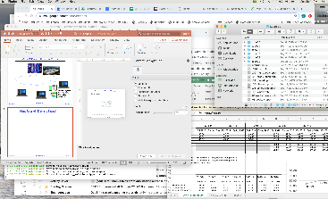
Very Different Situation Today
Powerful system
Huge memory
Huge disk
Single user

Slide 15
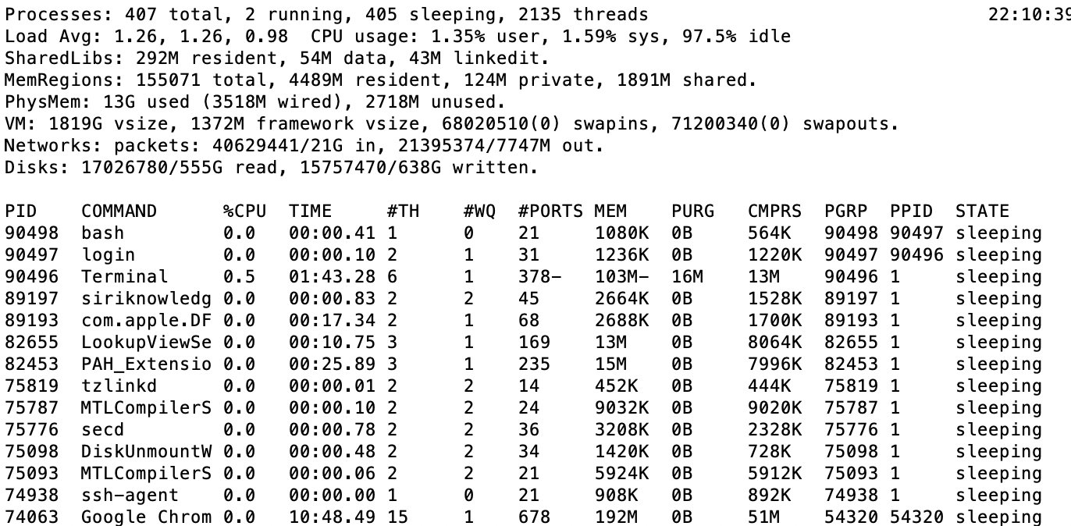
A Picture on one machine
Memory stays about 75% used, 25% for dynamics
A lot of it is shared 1.9 GB

Slide 16
Many Uses of Virtual Memory and “Demand Paging” …
Extend the stack
Allocate a page and zero it
Extend the heap (sbrk of old, today mmap)
Process Fork
Create a copy of the page table
Entries refer to parent pages – NO-WRITE
Shared read-only pages remain shared
Copy page on write
Exec
Only bring in parts of the binary in active use
Do this on demand
MMAP to explicitly share region (or to access a file as RAM)

Slide 17
Administrivia
I hope you all are remaining safe!
Wash your hands, practice good social distancing
Stay in touch with people however you can!!!!
We intend to keep teaching CS162 (virtually)!
Live lecture, discussion sections, and office-hours
Only one Friday section per time slot for now.
Sorry about disruptions in office hour
We are going to start recording walkthrough of section material and posting videos to help with your studies
We have relaxed some deadlines and added slip days
See Piazza post from this afternoon
We moved Midterm 2 to April 7th
This gives you a week after Spring Break to get settled
Still planning on 5-7pm (PDT!) time slot for the midterm
Material up to Lecture 17

Slide 18
Classic: Loading an executable into memory
disk (huge)
memory
info
data
code
exe
.exe
lives on disk in the file system
contains contents of code & data segments, relocation entries and symbols
OS loads it into memory, initializes registers (and initial stack pointer)
program sets up stack and heap upon initialization: crt0 (C runtime init)

Slide 19
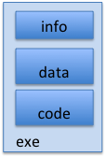
Create Virtual Address Space of the Process
disk (huge)
process VAS
memory
kernel
user page
frames
stack
sbrk
user pagetable
heap
data
kernel code & data
code
Utilized pages in the VAS are backed by a page block on disk
Called the backing store or swap file
Typically in an optimized block store, but can think of it like a file

Slide 20
Create Virtual Address Space of the Process
disk (huge, TB)
process VAS (GBs)
memory
kernel
stack
user page
frames
stack
heap
heap
user pagetable
data
data
code
kernel code & data
code
User Page table maps entire VAS
All the utilized regions are backed on disk
swapped into and out of memory as needed
For every process

Slide 21
Create Virtual Address Space of the Process
disk (huge, TB)
VAS – per process
PT
memory
kernel
stack
user page
frames
stack
heap
heap
user pagetable
data
data
code
kernel code & data
code
User Page table maps entire VAS
Resident pages to the frame in memory they occupy
The portion of it that the HW needs to access must be resident in memory

Slide 22
Provide Backing Store for VAS
disk (huge, TB)
VAS – per process
memory
kernel
stack
user page
frames
stack
heap
heap
user pagetable
data
data
code
kernel code & data
code
User Page table maps entire VAS
Resident pages mapped to memory frames
For all other pages, OS must record where to find them on disk

Slide 23
What Data Structure Maps Non-Resident Pages to Disk?
FindBlock(PID, page#) → disk_block
Some OSs utilize spare space in PTE for paged blocks
Like the PT, but purely software
Where to store it?
In memory – can be compact representation if swap storage is contiguous on disk
Could use hash table (like Inverted PT)
Usually want backing store for resident pages too
May map code segment directly to on-disk image
Saves a copy of code to swap file
May share code segment with multiple instances of the program

Slide 24
Provide Backing Store for VAS
disk (huge, TB)
VAS 1
PT 1
memory
kernel
stack
stack
stack
heap
user page
frames
heap
heap
data
VAS 2
PT 2
data
code
user pagetable
data
kernel
code
stack
kernel code & data
heap
data
code

Slide 25
On page Fault …
disk (huge, TB)
VAS 1
PT 1
memory
kernel
stack
stack
stack
heap
user page
frames
heap
heap
data
VAS 2
PT 2
data
code
user pagetable
data
kernel
code
stack
kernel code
& data
heap
data
active process & PT
code

Slide 26
On page Fault … find & start load
disk (huge, TB)
VAS 1
PT 1
memory
kernel
stack
stack
stack
heap
user page
frames
heap
heap
data
VAS 2
PT 2
data
code
user pagetable
data
kernel
code
stack
kernel code & data
heap
data
active process & PT
code

Slide 27
On page Fault … schedule other P or T
disk (huge, TB)
VAS 1
PT 1
memory
kernel
stack
stack
stack
heap
user page
frames
heap
heap
data
VAS 2
PT 2
data
code
user pagetable
data
kernel
code
stack
kernel code & data
heap
data
active process & PT
code

Slide 28
On page Fault … update PTE
disk (huge, TB)
VAS 1
PT 1
memory
kernel
stack
stack
stack
heap
user page
frames
heap
heap
data
VAS 2
PT 2
data
code
user pagetable
data
kernel
code
stack
kernel code & data
heap
data
active process & PT
code

Slide 29
Eventually reschedule faulting thread
disk (huge, TB)
VAS 1
PT 1
memory
kernel
stack
stack
stack
heap
user page
frames
heap
heap
data
VAS 2
PT 2
data
code
user pagetable
data
kernel
code
stack
kernel code & data
heap
data
active process & PT
code

Slide 30
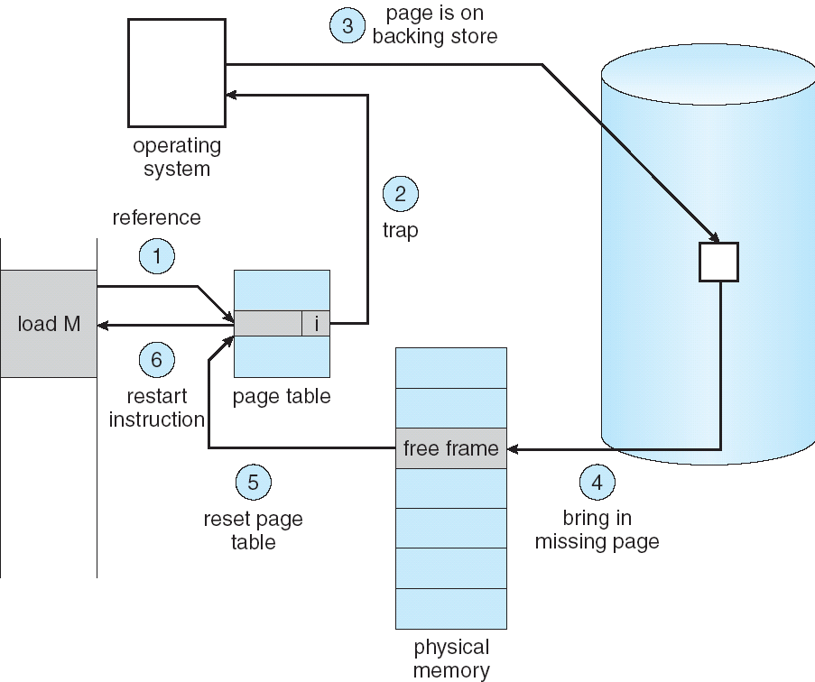
Summary: Steps in Handling a Page Fault

Slide 31
Some questions we need to answer!
During a page fault, where does the OS get a free frame?
Keeps a free list
Unix runs a “reaper” if memory gets too full
Schedule dirty pages to be written back on disk
Zero (clean) pages which haven’t been accessed in a while
As a last resort, evict a dirty page first
How can we organize these mechanisms?
Work on the replacement policy
How many page frames/process?
Like thread scheduling, need to “schedule” memory resources:
Utilization? fairness? priority?
Allocation of disk paging bandwidth

Slide 32
Working Set Model
As a program executes it transitions through a sequence of “working sets” consisting of varying sized subsets of the address space
Address
Time

Slide 33
Cache Behavior under WS model
1
new working set fits
Hit Rate
0
Cache Size
Amortized by fraction of time the Working Set is active
Transitions from one WS to the next
Capacity, Conflict, Compulsory misses
Applicable to memory caches and pages. Others ?

Slide 34
Another model of Locality: Zipf
Likelihood of accessing item of rank r is α 1/rª
Although rare to access items below the top few, there are so many that it yields a “heavy tailed” distribution
Substantial value from even a tiny cache
Substantial misses from even a very large cache

Slide 35
Demand Paging Cost Model
Since Demand Paging like caching, can compute average access time! (“Effective Access Time”)
EAT = Hit Rate x Hit Time + Miss Rate x Miss Time
EAT = Hit Time + Miss Rate x Miss Penalty
Example:
Memory access time = 200 nanoseconds
Average page-fault service time = 8 milliseconds
Suppose p = Probability of miss, 1-p = Probably of hit
Then, we can compute EAT as follows:
EAT = 200ns + p x 8 ms
= 200ns + p x 8,000,000ns
If one access out of 1,000 causes a page fault, then EAT = 8.2 μs:
This is a slowdown by a factor of 40!
What if want slowdown by less than 10%?
EAT < 200ns x 1.1 ⇒ p < 2.5 x 10⁻⁶
This is about 1 page fault in 400,000!

Slide 36
What Factors Lead to Misses in Page Cache?
Compulsory Misses:
Pages that have never been paged into memory before
How might we remove these misses?
Prefetching: loading them into memory before needed
Need to predict future somehow! More later
Capacity Misses:
Not enough memory. Must somehow increase available memory size.
Can we do this?
One option: Increase amount of DRAM (not quick fix!)
Another option: If multiple processes in memory: adjust percentage of memory allocated to each one!
Conflict Misses:
Technically, conflict misses don’t exist in virtual memory, since it is a “fully-associative” cache
Policy Misses:
Caused when pages were in memory, but kicked out prematurely because of the replacement policy
How to fix? Better replacement policy

Slide 37
Page Replacement Policies
Why do we care about Replacement Policy?
Replacement is an issue with any cache
Particularly important with pages
The cost of being wrong is high: must go to disk
Must keep important pages in memory, not toss them out
FIFO (First In, First Out)
Throw out oldest page. Be fair – let every page live in memory for same amount of time.
Bad – throws out heavily used pages instead of infrequently used
RANDOM:
Pick random page for every replacement
Typical solution for TLB’s. Simple hardware
Pretty unpredictable – makes it hard to make real-time guarantees
MIN (Minimum):
Replace page that won’t be used for the longest time
Great (provably optimal), but can’t really know future…
But past is a good predictor of the future …

Slide 38
Replacement Policies (Con’t)
LRU (Least Recently Used):
Replace page that hasn’t been used for the longest time
Programs have locality, so if something not used for a while, unlikely to be used in the near future.
Seems like LRU should be a good approximation to MIN.
How to implement LRU? Use a list!
On each use, remove page from list and place at head
LRU page is at tail
Problems with this scheme for paging?
Need to know immediately when each page used so that can change position in list…
Many instructions for each hardware access
In practice, people approximate LRU (more later)
Page 6
Page 7
Page 1
Page 2
Head
Tail (LRU)

Slide 39
Example: FIFO (strawman)
Suppose we have 3 page frames, 4 virtual pages, and following reference stream:
A B C A B D A D B C B
Consider FIFO Page replacement:
FIFO: 7 faults
When referencing D, replacing A is bad choice, since need A again right away
Ref:
Page:
A
B
C
A
B
D
A
D
B
C
B
1
A
D
C
2
B
A
3
C
B

Slide 40
Example: MIN / LRU
Suppose we have the same reference stream:
A B C A B D A D B C B
Consider MIN Page replacement:
MIN: 5 faults
Where will D be brought in? Look for page not referenced farthest in future
What will LRU do?
Same decisions as MIN here, but won’t always be true!
Ref:
Page:
A
B
C
A
B
D
A
D
B
C
B
1
A
C
2
B
3
C
D

Slide 41
Is LRU guaranteed to perform well?
Consider the following: A B C D A B C D A B C D
LRU Performs as follows (same as FIFO here):
Every reference is a page fault!
Fairly contrived example of working set of N+1 on N frames
Ref:
Page:
A
B
C
D
A
B
C
D
A
B
C
D
1
A
D
C
B
2
B
A
D
C
3
C
B
A
D

Slide 42
When will LRU perform badly?
Consider the following: A B C D A B C D A B C D
LRU Performs as follows (same as FIFO here):
Every reference is a page fault!
MIN Does much better:
Ref:
Page:
A
B
C
D
A
B
C
D
A
B
C
D
1
A
D
C
B
2
B
A
D
C
3
C
B
A
D
Ref:
Page:
A
B
C
D
A
B
C
D
A
B
C
D
1
A
B
2
B
C
3
C
D

Slide 43
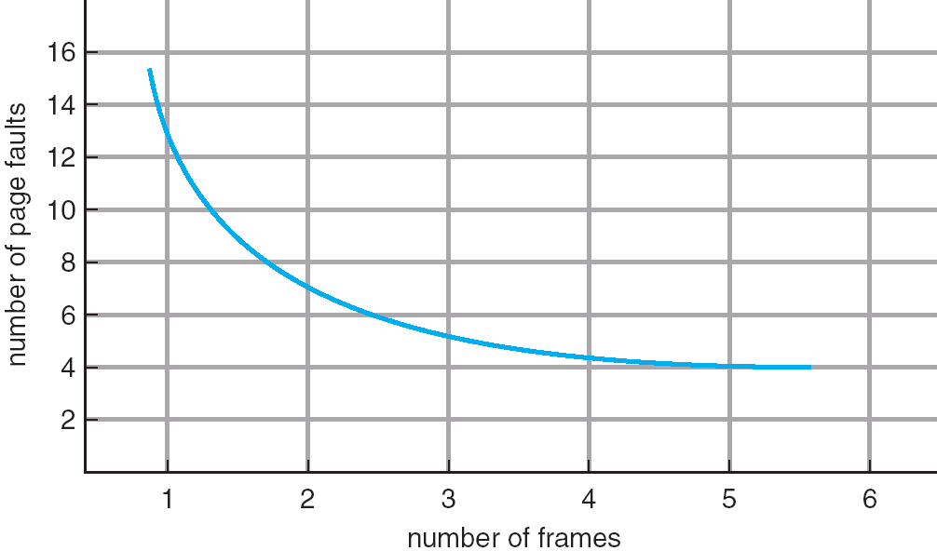
Graph of Page Faults Versus The Number of Frames
One desirable property: When you add memory the miss rate drops (stack property)
Does this always happen?
Seems like it should, right?
No: Bélády’s anomaly
Certain replacement algorithms (FIFO) don’t have this obvious property!

Slide 44
Adding Memory Doesn’t Always Help Fault Rate
Does adding memory reduce number of page faults?
Yes for LRU and MIN
Not necessarily for FIFO! (Called Bélády’s anomaly)
After adding memory:
With FIFO, contents can be completely different
In contrast, with LRU or MIN, contents of memory with X pages are a subset of contents with X+1 Page
Ref:
Page:
A
B
C
D
A
B
E
A
B
C
D
E
1
A
D
E
2
B
A
C
3
C
B
D
Ref:
Page:
A
B
C
D
A
B
E
A
B
C
D
E
1
A
E
D
2
B
A
E
3
C
B
4
D
C

Slide 45
Implementing LRU
Perfect:
Timestamp page on each reference
Keep list of pages ordered by time of reference
Too expensive to implement in reality for many reasons
Clock Algorithm: Arrange physical pages in circle with single clock hand
Approximate LRU (approximation to approximation to MIN)
Replace an old page, not the oldest page
Details:
Hardware “use” bit per physical page:
Hardware sets use bit on each reference
If use bit isn’t set, means not referenced in a long time
Some hardware sets use bit in the TLB; you have to copy this back to page table entry when TLB entry gets replaced
On page fault:
Advance clock hand (not real time)
Check use bit: 1→used recently; clear and leave alone 0→selected candidate for replacement
Will always find a page or loop forever?
Even if all use bits set, will eventually loop around ⇒ FIFO

Slide 46
Clock Algorithm: Not Recently Used
Set of all pages
in Memory
Single Clock Hand:
Advances only on page fault!
Check for pages not used recently
Mark pages as not used recently
What if hand moving slowly?
Good sign or bad sign?
Not many page faults and/or find page quickly
What if hand is moving quickly?
Lots of page faults and/or lots of reference bits set
One way to view clock algorithm:
Crude partitioning of pages into two groups: young and old
Why not partition into more than 2 groups?

Slide 47
N^{th} Chance version of Clock Algorithm
N^{th} chance algorithm: Give page N chances
OS keeps counter per page: # sweeps
On page fault, OS checks use bit:
1 → clear use and also clear counter (used in last sweep)
0 → increment counter; if count=N, replace page
Means that clock hand has to sweep by N times without page being used before page is replaced
How do we pick N?
Why pick large N? Better approximation to LRU
If N ~ 1K, really good approximation
Why pick small N? More efficient
Otherwise might have to look a long way to find free page
What about dirty pages?
Takes extra overhead to replace a dirty page, so give dirty pages an extra chance before replacing?
Common approach:
Clean pages, use N=1
Dirty pages, use N=2 (and write back to disk when N=1)

Slide 48
Clock Algorithms: Details
Which bits of a PTE entry are useful to us?
Use: Set when page is referenced; cleared by clock algorithm
Modified: set when page is modified, cleared when page written to disk
Valid: ok for program to reference this page
Read-only: ok for program to read page, but not modify
For example for catching modifications to code pages!
Do we really need hardware-supported “modified” bit?
No. Can emulate it (BSD Unix) using read-only bit
Initially, mark all pages as read-only, even data pages
On write, trap to OS. OS sets software “modified” bit, and marks page as read-write.
Whenever page comes back in from disk, mark read-only

Slide 49
Clock Algorithms Details (continued)
Do we really need a hardware-supported “use” bit?
No. Can emulate it similar to above:
Mark all pages as invalid, even if in memory
On read to invalid page, trap to OS
OS sets use bit, and marks page read-only
Get modified bit in same way as previous:
On write, trap to OS (either invalid or read-only)
Set use and modified bits, mark page read-write
When clock hand passes by, reset use and modified bits and mark page as invalid again
Remember, however, clock is just an approximation of LRU!
Can we do a better approximation, given that we have to take page faults on some reads and writes to collect use information?
Need to identify an old page, not oldest page!
Answer: second chance list

Slide 50
Second-Chance List Algorithm (VAX/VMS)
LRU victim
Directly
Mapped Pages
Marked: RW
List: FIFO
Overflow
Second
Chance List
Marked: Invalid
List: LRU
Access
Page-in
From disk
New
Active Pages
New
SC Victims
Split memory in two: Active list (RW), SC list (Invalid)
Access pages in Active list at full speed
Otherwise, Page Fault
Always move overflow page from end of Active list to front of Second-chance list (SC) and mark invalid
Desired Page On SC List: move to front of Active list, mark RW
Not on SC list: page in to front of Active list, mark RW; page out LRU victim at end of SC list

Slide 51
Second-Chance List Algorithm (continued)
How many pages for second chance list?
If 0 ⇒ FIFO
If all ⇒ LRU, but page fault on every page reference
Pick intermediate value. Result is:
Pro: Few disk accesses (page only goes to disk if unused for a long time)
Con: Increased overhead trapping to OS (software / hardware tradeoff)
With page translation, we can adapt to any kind of access the program makes
Later, we will show how to use page translation / protection to share memory between threads on widely separated machines
Question: why didn’t VAX include “use” bit?
Strecker (architect) asked OS people, they said they didn’t need it, so didn’t implement it
He later got blamed, but VAX did OK anyway

Slide 52
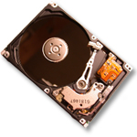
Free List
Set of all pages
in Memory
Single Clock Hand: Advances as needed to keep freelist full (“background”)
D
D
Free Pages
For Processes
Keep set of free pages ready for use in demand paging
Freelist filled in background by Clock algorithm or other technique (“Pageout demon”)
Dirty pages start copying back to disk when enter list
Like VAX second-chance list
If page needed before reused, just return to active set
Advantage: faster for page fault
Can always use page (or pages) immediately on fault

Slide 53
Demand Paging (more details)
Does software-loaded TLB need use bit? Two Options:
Hardware sets use bit in TLB; when TLB entry is replaced, software copies use bit back to page table
Software manages TLB entries as FIFO list; everything not in TLB is Second-Chance list, managed as strict LRU
Core Map
Page tables map virtual page → physical page
Do we need a reverse mapping (i.e. physical page → virtual page)?
Yes. Clock algorithm runs through page frames. If sharing, then multiple virtual-pages per physical page
Can’t push page out to disk without invalidating all PTEs

Slide 54
Allocation of Page Frames (Memory Pages)
How do we allocate memory among different processes?
Does every process get the same fraction of memory? Different fractions?
Should we completely swap some processes out of memory?
Each process needs minimum number of pages
Want to make sure that all processes that are loaded into memory can make forward progress
Example: IBM 370 – 6 pages to handle SS MOVE instruction:
instruction is 6 bytes, might span 2 pages
2 pages to handle from
2 pages to handle to
Possible Replacement Scopes:
Global replacement – process selects replacement frame from set of all frames; one process can take a frame from another
Local replacement – each process selects from only its own set of allocated frames

Slide 55
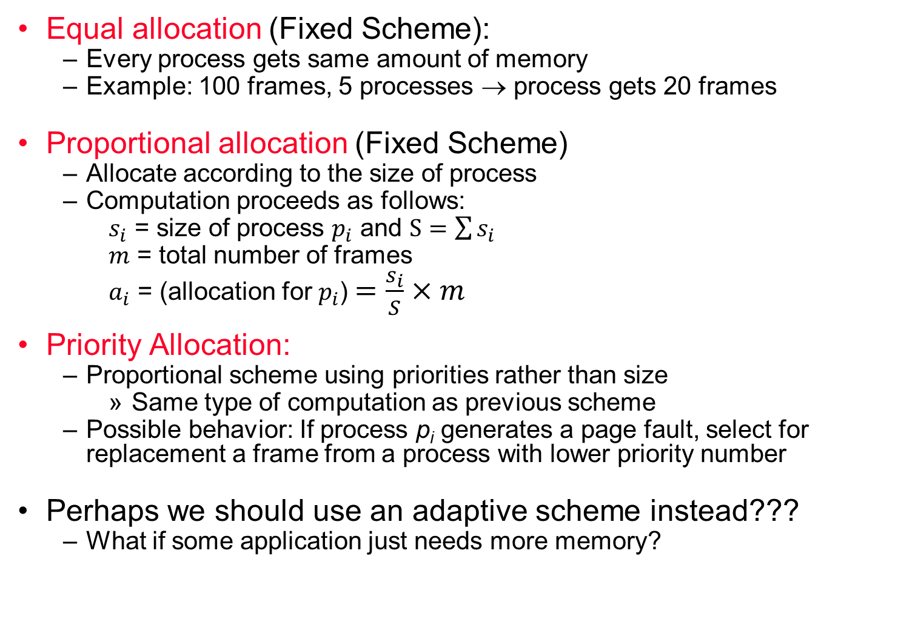
Fixed/Priority Allocation
Equal allocation (Fixed Scheme):
Every process gets same amount of memory
Example: 100 frames, 5 processes → process gets 20 frames
Proportional allocation (Fixed Scheme)
Allocate according to the size of process
Computation proceeds as follows:
$s_{i}$ = size of process $p_{i}$ and $S=\sum{s_{i}}$
$m$ = total number of frames
$a_{i}$ = (allocation for $p_{i}$)$=\frac{s_{i}}{S}×m$
Priority Allocation:
Proportional scheme using priorities rather than size
Same type of computation as previous scheme
Possible behavior: If process p_{i} generates a page fault, select for replacement a frame from a process with lower priority number
Perhaps we should use an adaptive scheme instead???
What if some application just needs more memory?

Slide 56
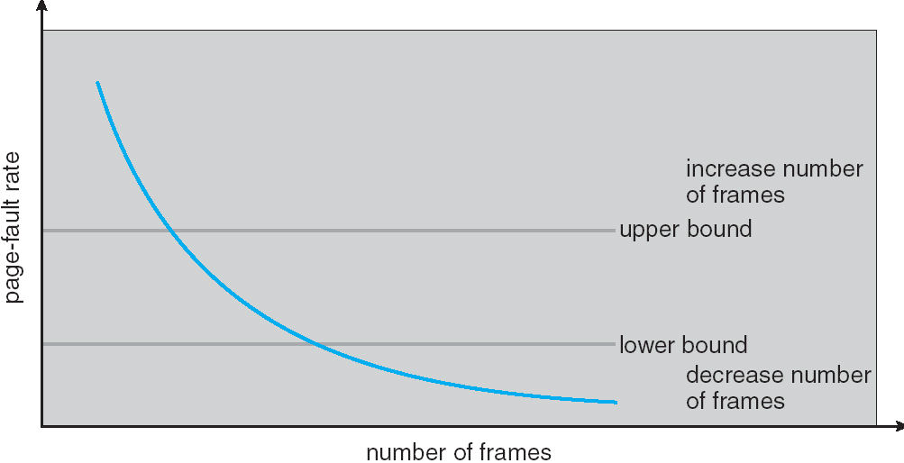
Page-Fault Frequency Allocation
Can we reduce Capacity misses by dynamically changing the number of pages/application?
Establish “acceptable” page-fault rate
If actual rate too low, process loses frame
If actual rate too high, process gains frame
Question: What if we just don’t have enough memory?

Slide 57
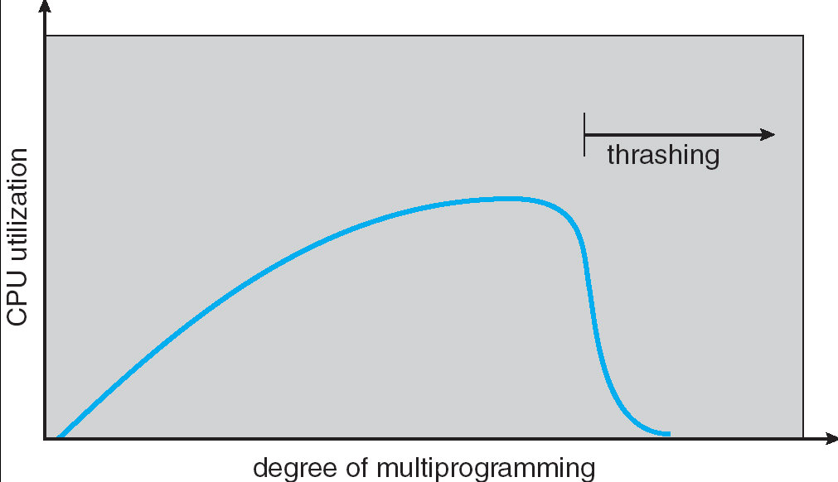
Thrashing
If a process does not have “enough” pages, the page-fault rate is very high. This leads to:
low CPU utilization
operating system spends most of its time swapping to disk
Thrashing ≡ a process is busy swapping pages in and out
Questions:
How do we detect Thrashing?
What is best response to Thrashing?
Notes:
Example: one program, touches 50 pages (each equally likely). Have only 40 physical page frames.
How bad is this?
- Does your program run at 80% speed?
- Does your program run at 20% speed?
Performance is really bad
If we have enough pages, 200 ns/ref, but if too few pages, assume every 5th page reference causes a page fault
= 4 refs x 200 ns
1 page fault x 10 ms for disk I/O
= 5 refs, 10 ms + 800 ns => 2 ms/ref (not 100 MIPS, but 500 IPS! Factor of 10,000)
Machine appears to have stopped!

Slide 58
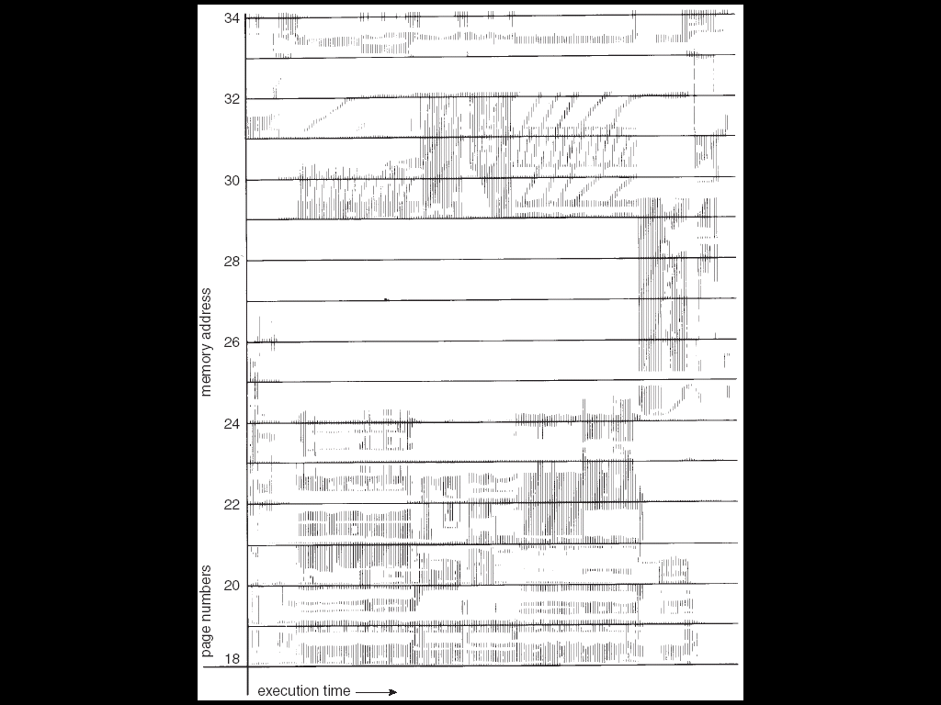
Locality In A Memory-Reference Pattern
Program Memory Access Patterns have temporal and spatial locality
Group of Pages accessed along a given time slice called the “Working Set”
Working Set defines minimum number of pages needed for process to behave well
Not enough memory for Working Set ⇒ Thrashing
Better to swap out process?

Slide 59
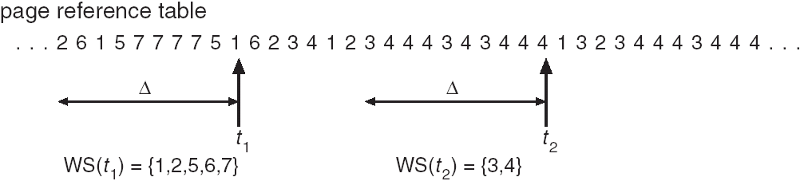
Working-Set Model
Δ ≡ working-set window ≡ fixed number of page references
Example: 10,000 instructions
WSi (working set of Process Pi) = total set of pages referenced in the most recent Δ (varies in time)
if Δ too small will not encompass entire locality
if Δ too large will encompass several localities
if Δ = ∞ ⇒ will encompass entire program
D = Σ|WSi| ≡ total demand frames
if D > m ⇒ Thrashing
Policy: if D > m, then suspend/swap out processes
This can improve overall system behavior by a lot!

Slide 60
What about Compulsory Misses?
Recall that compulsory misses are misses that occur the first time that a page is seen
Pages that are touched for the first time
Pages that are touched after process is swapped out/swapped back in
Clustering:
On a page-fault, bring in multiple pages “around” the faulting page
Since efficiency of disk reads increases with sequential reads, makes sense to read several sequential pages
Working Set Tracking:
Use algorithm to try to track working set of application
When swapping process back in, swap in working set

Slide 61
Reverse Page Mapping (Sometimes called “Coremap”)
Physical page frames often shared by many different address spaces/page tables
All children forked from given process
Shared memory pages between processes
Whatever reverse mapping mechanism that is in place must be very fast
Must hunt down all page tables pointing at given page frame when freeing a page
Must hunt down all PTEs when seeing if pages “active”
Implementation options:
For every page descriptor, keep linked list of page table entries that point to it
Management nightmare – expensive
Linux 2.6: Object-based reverse mapping
Link together memory region descriptors instead (much coarser granularity)

Slide 62
Linux Memory Details?
Memory management in Linux considerably more complex than the examples we have been discussing
Memory Zones: physical memory categories
ZONE_DMA: < 16MB memory, DMAable on ISA bus
ZONE_NORMAL: 16MB → 896MB (mapped at 0xC0000000)
ZONE_HIGHMEM: Everything else (> 896MB)
Each zone has 1 freelist, 2 LRU lists (Active/Inactive)
Many different types of allocation
SLAB allocators, per-page allocators, mapped/unmapped
Many different types of allocated memory:
Anonymous memory (not backed by a file, heap/stack)
Mapped memory (backed by a file)
Allocation priorities
Is blocking allowed/etc

Slide 63
Linux Virtual memory map
0xFFFFFFFF
0xFFFFFFFFFFFFFFFF
Kernel Addresses
1GB
Kernel Addresses
128TiB
896MB Physical
64 TiB Physical
0xC0000000
User Addresses
0xFFFF800000000000
3GB Total
Empty
Space
“Canonical Hole”
0x00007FFFFFFFFFFF
128TiB
User
Addresses
0x00000000
0x0000000000000000
32-Bit Virtual Address Space
64-Bit Virtual Address Space

Slide 64
Virtual Map (Details)
Kernel memory not generally visible to user
Exception: special VDSO (virtual dynamically linked shared objects) facility that maps kernel code into user space to aid in system calls (and to provide certain actual system calls such as gettimeofday())
Every physical page described by a “page” structure
Collected together in lower physical memory
Can be accessed in kernel virtual space
Linked together in various “LRU” lists
For 32-bit virtual memory architectures:
When physical memory < 896MB
All physical memory mapped at 0xC0000000
When physical memory >= 896MB
Not all physical memory mapped in kernel space all the time
Can be temporarily mapped with addresses > 0xCC000000
For 64-bit virtual memory architectures:
All physical memory mapped above 0xFFFF800000000000

Slide 65
Summary
Replacement policies
FIFO: Place pages on queue, replace page at end
MIN: Replace page that will be used farthest in future
LRU: Replace page used farthest in past
Clock Algorithm: Approximation to LRU
Arrange all pages in circular list
Sweep through them, marking as not “in use”
If page not “in use” for one pass, than can replace
N^{th}-chance clock algorithm: Another approximate LRU
Give pages multiple passes of clock hand before replacing
Second-Chance List algorithm: Yet another approximate LRU
Divide pages into two groups, one of which is truly LRU and managed on page faults.
Working Set:
Set of pages touched by a process recently
Thrashing: a process is busy swapping pages in and out
Process will thrash if working set doesn’t fit in memory
Need to swap out a process

